Slide 1
Building R-packages – basics
Raphael Hartmann
raphael.hartmann@staff.uni-marburg.de

Slide 2
Motivation
Building R-packages

Slide 3
Goal
Learn how to build/develop an R-package
Learn useful functions and workflows to improve efficiency
Learn goes and no-goes

Slide 4
Reasons
Share code with others
Make your functions and datasets easily accessible
It saves yourself time when reusing old functions of yours
You can also build a package to make reproducible data analysis (Marwick et al., 2018)

Slide 5
Setup
Building R-packages

Slide 6
Notes
Code syntax:
R code (and C/C++ code)
Terminal/shell code (bash) in RStudio terminal

Slide 7

Packages needed in R
You need to install devtools in R/Rstudio
install.packages("devtools")
Run the following line of code in RStudio to make sure you have everything set:
Devtools::has_devel()

Slide 8
Windows Setup
Building R-packages

Slide 9
Programs you need
MikTeX (LaTeX):
https://miktex.org/download
Download and install like all other programs
Open MikTeX and search for updates and install them
https://fonts.google.com/specimen/Inconsolata#standard-styles
Download and extract ZIP content
Go to „Start > Settings > Personalization > Fonts“
Drag and drop „Inconsolata-VariableFont_wdth,wght.ttf“ in the „drag-and-drop“ field

Slide 10
Programs you need
Depending on your R version you need:
Rtools4.0 (for R version 4.0.0 to 4.1.3):
https://cran.r-project.org/bin/windows/Rtools/rtools40.html
Download and install as usual
Rtools4.2 (for R version >= 4.2.0):
https://cran.r-project.org/bin/windows/Rtools/rtools42/rtools.html
Download and install as usual

Slide 11
macOS Setup
Building R-packages

Slide 12
Programs you need
You only need Xcode command line tools:
Install the current release of full Xcode: https://apps.apple.com/ca/app/xcode/id497799835?mt=12

Slide 13
Main Literature
Building R-packages

Slide 14

Most important literature
Writing R extensions (WRE) manual:
Main source for writing R-packages → the standard
html: https://cran.r-project.org/doc/manuals/R-exts.html
pdf: https://cran.r-project.org/doc/manuals/R-exts.pdf
Whenever in doubt look it up in WRE!

Slide 15
Additional literature
R-packages:
Book of Hadley Wickham and Jenny Bryan, open available at https://r-pkgs.org/
Who did what?
Paper about the roles of people who contributed to the package
pdf: https://epub.wu.ac.at/6395/1/RJ-2012-009.pdf
All about R:
https://cran.r-project.org/ → Manuals (bottom left)

Slide 16
Additional literature
R-package building in Windows:
https://cran.r-project.org/bin/windows/base/howto-R-4.2.html

Slide 17
Structure of R-packages
Building R-packages

Slide 18
Learning objective
What is the structure of an R-package?
Which files and directories are needed and which are optional?
How can you automatically generate a package skeleton?
What are the stages of an R-package?

Slide 19



Package – skeleton
mandatory files/directories
optional files/directories
pkgname/
man/
R/
data/
demo/
po/
src/
tests/
tools/
…
…
vignettes/
DESCRIPTION
NAMESPACE
INDEX
configure
cleanup
LICENSE or LICENCE
NEWS

Slide 20
Package – restrictions
None of the subfolders (data, demo, etc.) should be empty
If subfolder not used → remove it / don‘t generate it
Do not use the following symbols in file names:
‘"’, ‘*’, ‘:’, ‘/’, ‘<’, ‘>’, ‘?’, ‘\’, and ‘|’ as well as
ASCII control characters
There are other restrictions in https://cran.r-project.org/doc/ manuals/r-release/R-exts.html#Package-structure

Slide 21
Package name
There are also some restrictions for package names:
You can only use letters, numbers, and periods, but
it must start with a letter and
it must not end with a period
Suggestions:
Do not use periods since they might confuse people (the package name might look like a file with a special file extension)
You might want to use available::available(name, browse = TRUE) to check whether your package name is already in use

Slide 22
Package – make skeleton
A skeleton with the most important files and folders can be created by
package.skeleton(name = "anRpackage", list, environment = .GlobalEnv, path = ".", force = FALSE, code_files = character(), encoding = "unknown")
Downside: you need at least one R-object for the argument list.

Slide 23

Package – make skeleton
An easier way to do it is by using the usethis package (part of devtools)
usethis::create_package(path, fields = list(), rstudio = rstudioapi::isAvailable(), roxygen = TRUE, check_name = TRUE, open = rlang::is_interactive())

Slide 24

Short exercise
2
Build the skeleton for your first R-package
Set your working directory where you want your package-folder
Use the usethis::create_package() function
Use an arbitrary name like "mypkg" in the path argument
Set rstudio = TRUE, roxygen = TRUE, and open = TRUE
Note: If you do not wish to generate an R-project file set rstudio = FALSE and if you do not wish to open a new RStudio window set open = FALSE.

Slide 25
Alternatives for building a package skeleton
In Rstudio create a new Project
„File > New Project… > New Directory > R Package“
Fill in the form:
„Package name:“
„Create project as subdirectory of:“
Press „Create Project“
Yet another alternative is devtools::create()

Slide 26
The five states of an R-package
Source package
Bundled package
Binary package
Installed package
In-Memory package

Slide 27
The five states of an R-package
Source:
What we have so far: a folder with subdirectories and some files
Bundled:
A compressed single file with the content of the package folder with some exceptions:
Vignettes are already compiled to HTML and PDF
Some temporary files will be missing
Any files listed in .Rbuildignore (e.g., your Rproj-file; see later)
This state is needed when you want to submit to CRAN

Slide 28
The five states of an R-package
Binary:
Binary packages include, as the name suggests, binary code. This is especially intresting if you have C/C++ code in your package that needs to be compiled for each operating system separately.
Installed:
A binary package that is decompressed into a package library.

Slide 29
The five states of an R-package
In-Memory:
The command pkg::fnc() loads the package temporarily
The commands library() and require() load the installed package and attach it to the search path
For package building neither library() nor require() are helpful
Never use library() or require() in your package!

Slide 30
DESCRIPTION File
Building R-packages

Slide 31
Learning objective
What is the content of the DESCRIPTION file?
What of it is needed and what is optional/conditional?

Slide 32
Prototype by WRE manual
Package: pkgname
Version: 0.5-1
Date: 2015-01-01
Title: My First Collection of Functions
Authors@R: c(person("Joe", "Developer", role = c("aut", "cre"),
email = "Joe.Developer@some.domain.net"),
person("Pat", "Developer", role = "aut"),
person("A.", "User", role = "ctb",
email = "A.User@whereever.net"))
Author: Joe Developer [aut, cre],
Pat Developer [aut],
A. User [ctb]
Maintainer: Joe Developer <Joe.Developer@some.domain.net>
Depends: R (>= 3.1.0), nlme
Suggests: MASS
Description: A (one paragraph) description of what
the package does and why it may be useful.
License: GPL (>= 2)
URL: https://www.r-project.org, http://www.another.url
BugReports: https://pkgname.bugtracker.url
mandatory fields
„optional“ fields

Slide 33
Mandatory fields
Package: just write your desired package name
Only restriction: package name not already used in CRAN repository
Version: there are many conventions
Best practice: X.Y-Z
Also common: X.Y.Z
Z: minor changes/updates (patches); Y: larger changes; X: changes that affec the user (i.e., previous code not working anymore)
Special: 0.01 or 0.01.0 → 0.1-0

Slide 34
Mandatory fields
Date: usually filled in by R-package roxygen2 (see later), but at least by CRAN if you submit it there.
Title: short description for your R-package (see other packages for inspiration)

Slide 35
Mandatory fields
Author@R: this replaces the Author and Maintainer fields:
Concatenate (c) of person objects with names and role:
person(given = NULL, family = NULL, middle = NULL, email = NULL, role = NULL, comment = NULL, first = NULL, last = NULL)
Roles:
"aut" (author; contributet much to the package and should be cited)
"cre" (creator; package maintainer)
"ctb" (contributor; gave code but does not need to be cited)
"cph" (copyright holder; legal name for an institution or corporate body)
Each person can have multiple roles
Notes:
Mention the paper „Who did what“

Slide 36
Mandatory fields
Description: comprehensive description of what the package does.
Only one paragraph!
Do not start with the package name, „this package“, or similar
Use double quotes (") for quotations (including titles of books and articles)
Use single quotes (') for non-English usage, including names of other packages and external software
Use angle brackets for DOI and URL
E.g., Klauer and Kellen (2018, <doi:10.1016/j.jmp.2017.12.003>)
Here, the package name should be explained if necessary

Slide 37
Mandatory fields
Licence or License: typically something like GPL-2, GPL-3 or GPL (>= 2) and many others
When in doubt check other similar packages
Be careful when using proprietary libraries (in R, C/C++, etc.)
Some universities have their own licence like the MIT: MIT
Check https://cran.r-project.org/doc/manuals/R-exts.html#Licensing for more details
Notes:
Mention NAG in rtmpt

Slide 38
Short exercise
5
Fill in all needed fields of your DESCRIPTION file

Slide 39
Optional fields
Depends: If your package depends on a certain R version, e.g., version 4.2.0 or higher, write R (>=4.2.0). Only in rare cases it is necessary to name another R-package here. This will add the named package also to the search path if the user loads and attaches your package
Example where it is needed: lmerTest depends on lme4.
Imports: This is where you list almost all packages whose functions and data sets you use in your main code. Exceptions are on the next slide.

Slide 40
Optional fields
Suggests: Here you list packages that you only need for vignettes, examples or tests, but are not essential for the functions of your package to work.

Slide 41
Optional fields
URL: list of URLs separated by commas or whitespace:
Homepage of author
Page with additional material/information
BugReports: single URL to where bug reports should be submitted:
Will send the bug report to this URL instead of e-mailaddress of maintainer
Notes:
For bug report show „CRAN Rcpp“

Slide 42
Optional fields
LazyData: logical (true or false) field controls whether the R datasets use lazy-loading (i.e., if false the user needs to load your data with data(mydata) and if true the user can access it by typing mydata)
VignetteBuilder: names (in a comma-separated list) packages that provide an engine for building vignettes: e.g.: knitr
NeedsCompilation: write yes if you have C++ code that needs to be compiled. Otherwise remove the field.

Slide 43
NAMESPACE File
Building R-packages

Slide 44
Learning objective
What information is written in the NAMESPACE file?
How can this be automated?

Slide 45
NAMESPACE elements
Your package might include functions of other packages. These packages with the used functions are listed here as follows:
importFrom("lme4", lmer)
Your package includes functions that should be available for the users. These functions are listed here as follows:
export(fnc)

Slide 46
NAMESPACE elements
There are some special methods and functionality that needs to be listed here as well:
S3method(print, fnc_output_class)
useDynLib("pkg", .registration=TRUE)

Slide 47
The good news
All this can be handled by the package roxygen2 when making the documentation (see next topic)
Note: you can do it yourself without roxygen2 but this is tedious

Slide 48
Help Files / Documentation
Building R-packages

Slide 49
Motivation
Documentation is needed for
Functions which users of the package can use
Data which users might use
Package-overview
Documentation helps you and the user:
Whenever you get back to your functions after some time it helps to have documentation
The user, of course, does not know what your functions do

Slide 50
Learning objective
How does the roxygen2 syntax work?
How can you write documentation for functions, data, and the package-overview?

Slide 51

Documentation with roxygen2
The roxygen2 package allows to write documentation directly within your R script (within the /R subfolder) where your functions are defined
It is installed automatically when installing devtools
Every line of documentation starts with #' and is structured by certain tags with an @ in front of it (see next slide)

Slide 52
Prototyp of an R script describing a function
#' Elementwise Square
#'
#' \code{fnc} returns square of each element of a numeric vector.
#'
#' @param x A numeric vector (or scalar).
#' @return The output is a vector with the same length as \code{x}.
#' @examples
#' fnc(c(1,2,4))
#' \dontrun{
#' fnc("a")
#' }
#' @export
fnc <- function(x) {x^2}

Slide 53
Tags in roxygen2
The most important tags are:
@title: very short description (< 65 characters). Use capitalization and no period at the end. Does not have to be written out (see previous slide)
@description: a paragraph (a few lines) describing what the function does. If this tag is not provided, the title tag is used as description. Does not have to be written out; The second separated line is taken as description (see previous slide)

Slide 54
Tags in roxygen2
The most important tags for functions are:
@param: each function argument should have its own parameter tag. After @param the argument name must be provided, then a short description of the argument
@return: a description of what the function returns, e.g., a (named) list, a data frame, vector, or scalar.
@export: this tells roxygen2 that the function needs to be exported (i.e., it should be available for the user, which is important for the NAMESPACE file)

Slide 55
Tags in roxygen2
The most important tags for functions are:
@examples: here you make a line break and then wirte code that can (potentially) be executed. There are four types of code here:
x <- runif(10) Plain code which is shown in the help file and run in example() and R CMD check
\dontshow{log(x)} Code which is run by example() and R CMD check but not shown in the helpfile (i.e., included just for testing)
\dontrun{plot(x)} Code which is shown but not run
\donttest{exp(x)} Code that is not run by R CMD check but run by example() and shown in help file

Slide 56

Workflow
Repeat the following until you are satisfied:
Add/change roxygen comments to/in your R script
Compilation: do either of these
run devtools::document() (which calls roxygen2::roxygenize())
press Ctrl/Cmd+Shift+D
Preview documentation with the ?-symbol (e.g., ?fnc)

Slide 57
Short exercise
5
Write a short custom R function in an R script (fnc1.R)
Write the roxygen comments for your function
Use the Workflow described in the previous slide. Change the compilation method each time you make changes:
Run command (devtools::document())
Press short-cut (Ctrl/Cmd+Shift+D)

Slide 58
Additional useful commands in brief
#' @importFrom another_pkgname fnc1 fnc2
#' @references
#' Klauer, K. C. (2010). Hierarchical multinomial processing tree
#' models: A latent-trait approach. \emph{Psychometrika, 75(1)}, 70-98.
#' doi:\doi{10.1007/s11336-004-1188-3}
#' @author Raphael Hartmann
#' @useDynLib "pkgname", .registration=TRUE
#' @seealso \code{\link{functionname}}
#' @section Arbitrary sectiontitle:
#' Write what you need in you custom section.

Slide 59
Tags in roxygen2
Additional (important) tags for functions are:
@importFrom: If you use functions from another package (e.g., stats) you need to name them here. This tells roxygen2 that the function(s) of the package another_pkgname should be imported, which is important for the NAMESPACE file)
@references: Name all papers which your package builds on.
@authors: Name yourself (and others who have wrote on the function)

Slide 60
Tags in roxygen2
Additional (important) tags for functions are:
@useDynLib: If your function uses C/C++ code
@seealso: Here you can make references to other functions (of yours)
@section: Write a custom section in your help file. Typically, you won‘t need this.

Slide 61
Short exercise
2
Change your function so that you need a function of another package (e.g., runif() of the stats package) → Adapt DESCRIPTION file
Change the documentation accordingly, if needed.
Let roxygen2 know that you want to import the corresponding function from a package by providing the tag @importFrom
Additionally you can add your name as author and add a reference to some arbitrary paper by using @author and @references, respectively

Slide 62
Data documentation
Data does not exist as R code!
Therefore we need to generate an R script, in which we describe the dataset as detailed as possible (see next slide).

Slide 63
Prototype of an R script for data documentation
#' Prices of 50,000 round cut diamonds.
#'
#' A dataset containing the prices and other attributes of almost 54,000
#' diamonds.
#'
#' @format A data frame with 53940 rows and 10 variables:
#' \describe{
#' \item{price}{price, in US dollars}
#' \item{carat}{weight of the diamond, in carats}
#' ...
#' }
#' @source \url{http://www.diamondse.info/}
"diamonds"
Name of R object (data.frame), not of .RData file
Notes:
Do not export this.

Slide 64
Tags in roxygen2
The most important tags for data are:
@format: here you describe the structure of your dataset:
You can use \describe{} and \item{variable}{variable description} to make the description look nicer
@usage: if you use LazyData: true in the DESCRIPTION file then this is not needed, but if not you must write data(mydat) here
@source: typically just an \url{https://...} if you did not simulate the data (you can, of course, write simulated or Simulation here)

Slide 65
Tags in roxygen2
The most important tags for data are:
@examples: here you make a line break and then wirte code that can (potentially) be executed. This is basically the same as for functions.

Slide 66
Package-overview documentation
There is also no R code for the package-overview!
Therefore we need to generate an R script, in which we describe the package-overview (see next slide).

Slide 67
Prototype of package-overview documentation
#' pkgname: A toy package
#'
#' The package pkgname provides one function and a dataset:
#' fnc, a function to calculate the square and
#' df, a data frame with random values.
#'
#' @section Functions:
#' The functions ...
#' @section Datasets:
#' The datasets ...
#' @docType package
#' @name pkgname
NULL

Slide 68
Formatting text
For ways to format and mark text within the documentation, see https://cran.r-project.org/doc/manuals/R-exts.html#Marking-text or https://r-pkgs.org/man.html#text-formatting

Slide 69
Short exercise
5
Generate a new R script with documentation for your package-overview
Generate some random data frame (e.g., mydat) in the console and save it as mydata1.RData in the data/ subfolder. Generate a new R script with documentation for your data.
Inspect the help pages for both
Notes:
Warning! Should appear

Slide 70
Alternative to roxygen2
You can write your documentation directly in the man/ subdirectory
WRE gives a guide on how to do it: https://cran.r-project.org/doc/manuals/R-exts.html#Writing-R-documentation-files
This way you have to write an .Rd file for each function and dataset

Slide 71
Terminal Commands and Alternatives
Building R-packages

Slide 72
Why learning the terminal commands
WRE will often talk in terms of terminal commands and not R commands that devtool and co. use.
Whenever you are unsure about a topic and need to consult WRE, you need to know at least the basics.
Therefore it helps to know a little bit about the bash (terminal) syntax.

Slide 73
Learning objective
What are the most important terminal commands?
What are the alternatives for those commands?

Slide 74


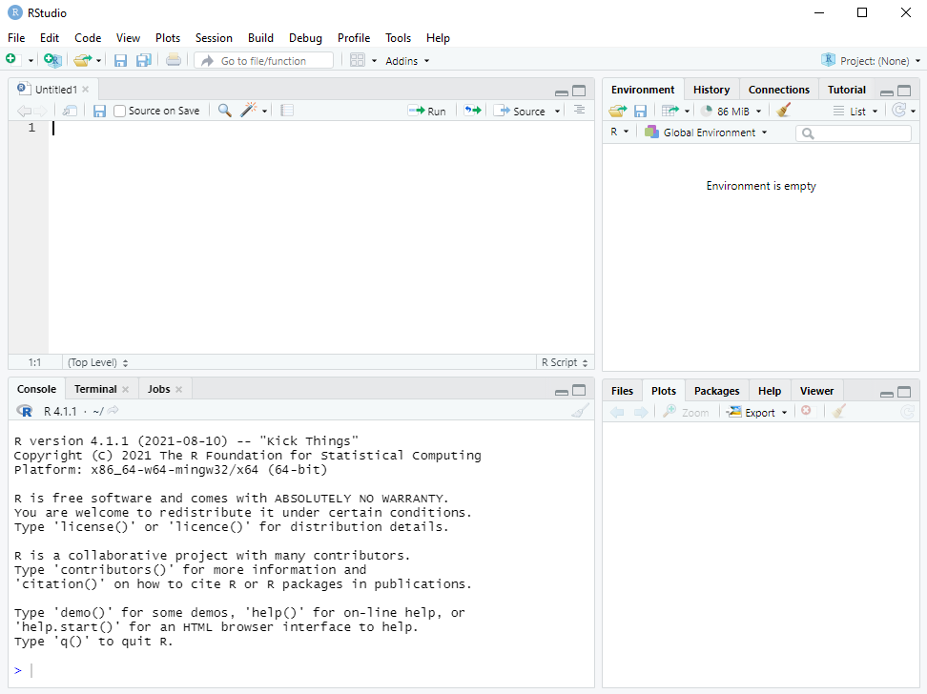
RStudio terminal
Notes:
Linux and Mac users can use the native terminal

Slide 75
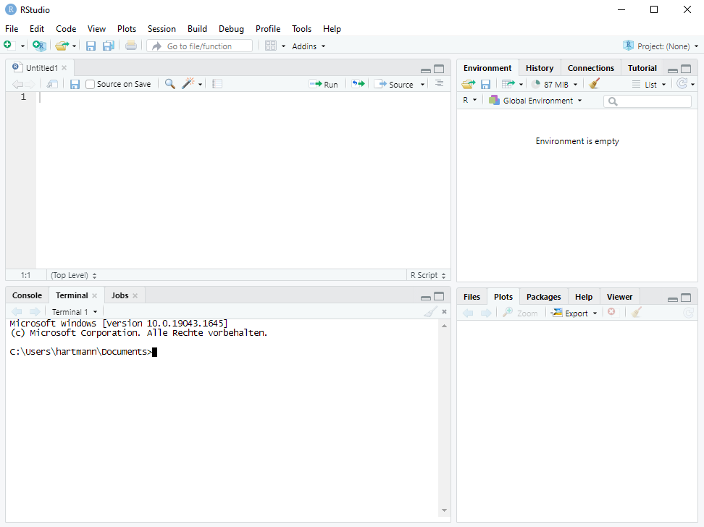
RStudio terminal

Slide 76
Navigation in the (RStudio) terminal (bash)
You can change your current directory with the command cd and list the content of the current directory with ls.
Change to the subdirectory R/:
cd R/
list the content of R/:
ls .
Change to the parent folder (the superfolder) of R/ (i.e., pkgname/):
cd ..
Change to the parent folder of the package (i.e., where pkgname/ lies):
cd ..
Notes:
Show participants the Rstudio options and how to use the terminal

Slide 77
Building and installing the basic package
In the terminal you can generate the tarball (tar.gz file):
R CMD build pkgname
Check the basic package with (but replace 0.0-1 with the current version)
R CMD check pkgname_0.0-1.tar.gz
Install the basic package with (but replace 0.0-1 with the current version)
R CMD INSTALL pkgname_0.0-1.tar.gz

Slide 78

CRAN check
If you want to submit your package to CRAN you need to run the following command and there must not be an Error or Warning (Notes are ok‘ish):
R CMD check --as-cran pkgname_0.0-1.tar.gz
See https://r-pkgs.org/r-cmd-check.html for common errors

Slide 79
Short exercise
5
Do the following in your RStudio terminal:
Generate the package tarball
Check the package tarball (for CRAN-feasibility)
Install the package
Note: if there are some errors or warnings in either of the steps, copy them (text from a terminal can be copied by right-click and „copy“) somewhere and try to solve them → we will discuss them!
Notes:
Warning! Should appear
Problem mit latex: https://tex.stackexchange.com/questions/125274/error-font-ts1-zi4r-at-540-not-found

Slide 80
Build, check, and install using R functions
Use devtools::build() to build a bundled package
You can also build a binary package by using binary = TRUE
Use devtools::check() to build and check a bundled package
Per default this checks for CRAN-feasibility
Use devtools::install() to build a bundled package and install it

Slide 81
.Rbuildignore
Whenever you have additional notes and data that does not need to be in your package and is just for you .Rbuildignore helps you
Opt-out list: everything that is listed in .Rbuildignore will not be part of the bundled package. It might look like:
^.*\.Rproj$
^\.Rproj\.user$
README\.Rmd$
...

Slide 82
Clean-up for building a bundled package
But how to handle .Rbuildignore?
An easy way to exclude files and subdirectories is:
usethis::use_build_ignore(files = c("name"))
Where "name" ist the name of a file or subdirectory
Note (to Linux users): Do not use a period and a slash in front of the name(s) to indicate that you mean the subdirectory in the current location. The command takes the name(s) literally!
Note to Windows users: Do not use back-slashes in the path to a file in a subdirectory!

Slide 83
Short exercise
2
Generate an arbitrary subdirectory in your package directory and some random file like „random_file.txt“ in this new directory
Use devtools::build() to build your package and check the structure of the bundled package
Use usethis::use_build_ignore() with the file path and check again the structure of the bundled package
Notes:
Warning! Should appear

Slide 84
General Workflow
Building R-packages

Slide 85
Workflow
Repeat the following until you are satisfied:
Edit an R file (e.g., a function within an R file)
If you have made any changes that impact help files or NAMESPACE, then use devtools::document()
Load the source package into memory (attach it to the search path; see next slide)
Explore the code in the console
Check the package

Slide 86
Loading a source package into memory
Usually, you do not install your package and test it. You only load and attach its functions etc. to the search path:
devtools::load_all()
You can have the same effect by clicking
„Build > Load All“
… or by pressing
Ctrl/Cmd+Shift+L

Slide 87
Short exercise
2
Empty your global environment
Load your function/s with devtools::load_all() and execute the one of your functions with some arbitrary values
Is/are your package function/s in the global environment?
Notes:
Warning! Should appear

Slide 88
Summary
Building R-packages

Slide 89
The most important commands
Goal | R comand
Check package name availability | available::available(name)
Create package skeleton | usethis::create_package(path)
Load everything from your package | devtools::load_all()
Build package documentation via roxygen2 | devtools::document() (→ ?/help())
Exclusion list for bundled package | usethis::use_build_ignore(files)
Check package for (CRAN) feasibility | devtools::check()
Build final bundled package (for CRAN) | devtools::build()
Install package | devtools::install()
Notes:
Some of these steps can be optimized. For example testing the functions in your package.

Slide 90
A possible R-package
Building R-packages

Slide 91
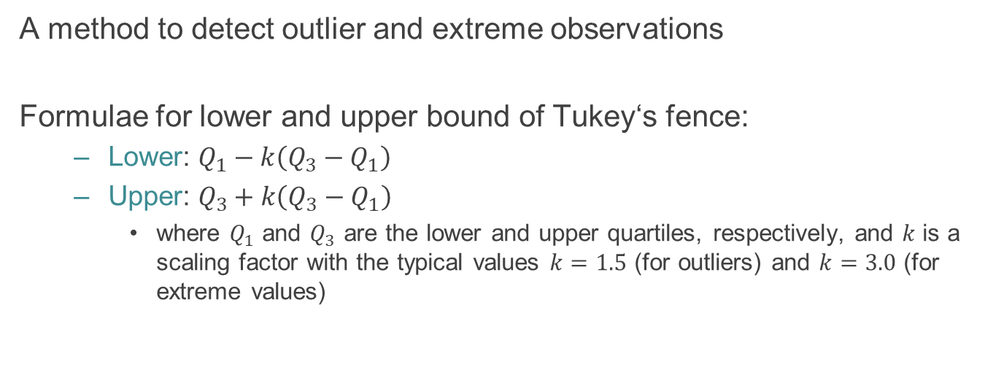
Tukey‘s fence
A method to detect outlier and extreme observations
Formulae for lower and upper bound of Tukey‘s fence:
Lower: $Q_{1}−k\left(Q_{3}−Q_{1}\right)$
Upper: $Q_{3}+k\left(Q_{3}−Q_{1}\right)$
where $Q_{1}$ and $Q_{3}$ are the lower and upper quartiles, respectively, and $k$ is a scaling factor with the typical values $k=1.5$ (for outliers) and $k=3.0$ (for extreme values)

Slide 92
Exercise
30
Build the basic R-package for Tukey‘s fence using what we have learned so far, either
Together (you tell me what to do) or
in small groups (and I help)
Alternative Exercise: you decide your own small project

Slide 93
Other topics to discuss
(meta)data
Git and GitHub
Testing
Vignettes
C/C++ integration

